Slide 1
Radon Transform
Section 2
Unit 4

Slide 2
Introduction
The Radon transform is named after the Austrian mathematician Johann Karl August Radon (December 16, 1887 – May 25, 1956) .
The Radon transform is a remarkably versatile tool that finds application in many areas of medicine and applied physics.
The Radon transform is widely applicable to tomography, the creation of an image from the scattering data associated to cross-sectional scans of an object
The Radon transform data is often called a sinogram

Slide 3
Introduction cont’d
In two dimensions (2D), the Radon transform is the set of all line-integral projections of a 2D function f(r).
For example, line integrals of the x-ray attenuation coefficient are obtained in computed tomography by passing a pencil beam of x-rays through a section of the body.
In single-photon emission computed tomography (SPECT), a parallel-hole collimator defines a pencil-like region of the body, so again line integrals are obtained, this time of the activity distribution.
And in positron-emission tomography (PET), coincident detection of two annihilation gamma rays defines a line through the body, and line integrals of the positron activity are measured.
The Radon transform in 3D refers to integrals over planes rather than lines. Plane integrals occur in some kinds of magnetic resonance imaging and in nuclear medicine if a slat collimator is used.

Slide 4
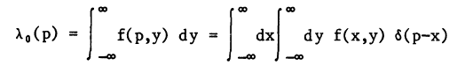
Radon Transform
The 1D projection of a 2D function f(x,y), with the projection being defined by line integrals along a series of lines parallel to the y axis
The projection along the line x=ρ, denoted λ_{θ}(ρ), is given by

Slide 5
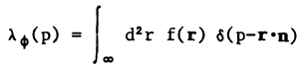
Radon Transform
A more general projection is along the line ρ = r*n. In this case the projection is given by
where the integral runs over the infinite plane, and φ is the angle between the x axis and the unit vector n

Slide 6
Radon Transform
The projection λ_{θ}(p), can be regarded either as a 1D function of ρ, parameterized by θ, or as a function in a 2D space with polar coordinates p and θ
The scalar ρ is thus the magnitude of the vector ρ, and θ is its polar angle relative to the x axis

Slide 7
Radon Transform
Applying the Radon transform on an image f(x,y) for a given set of angles can be thought of as computing the projection of the image along the given angles
The resulting projection is the sum of the intensities of the pixels in each direction, i.e. a line integral.
The result is a new image R(p,φ).

Slide 8
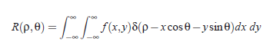
Radon Transform
This can be written mathematically by defining
ρ = x cosθ+ ysinθ
after which the Radon transform can be written as

Slide 9
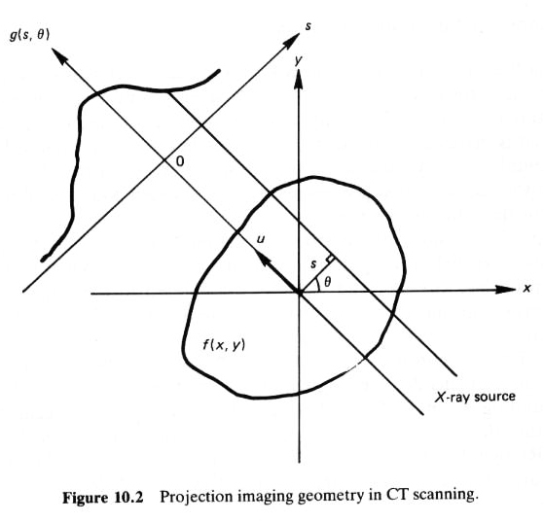
Radon Transform Principles
A linear transform f(x,y) → R(p,θ)
Line integral or “ray-sum”
Along a line inclined at angle θ from y-axis and s away from origin
Fix θ to get a 1-D signal R_{θ}(s)
We have now a set of images R_{θ}(s) which represent R(p,θ)
(From Jain’s Fig.10.2)
This is a transform from 2D to 2D spaces

Slide 10
Computed Tomography Example

Slide 12
Radon Transform and CT

Slide 13
Example

Slide 14
Example

Slide 15
Example

Slide 16
Example

Slide 17
Example

Slide 18
Example

Slide 19
Example

Slide 20

Full circle in RT

Slide 21

Empty circle in RT

Slide 22
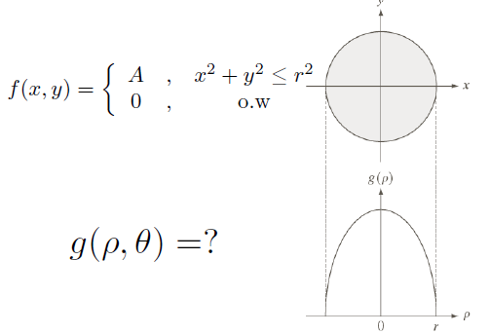
RT of circle: Example

Slide 23
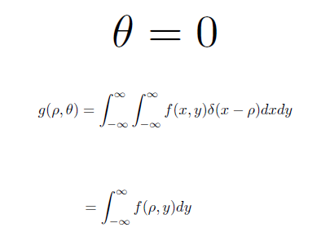
RT of circle: Example

Slide 24
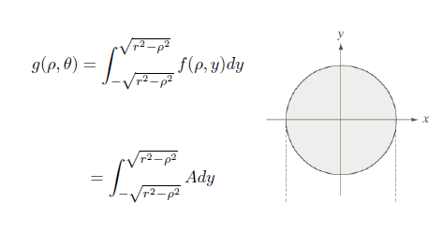
RT of circle: Example

Slide 25
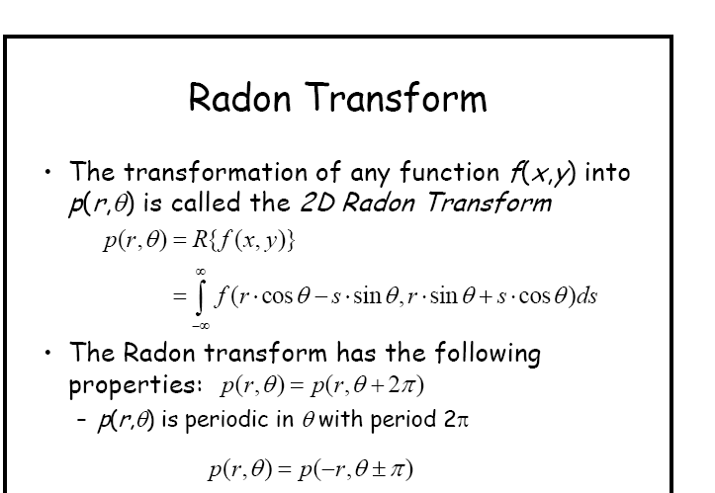
RADON TRANSFORM Properties
REMEMBER: f(x,y) → p(r,θ)

Slide 26
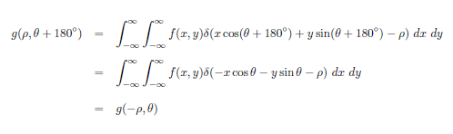
Properties

Slide 27
Radon transform properties
Image of any f + g is F + G
Image of cf is cF for any real c
Rotation of f causes translation of F in α
Scaling of f in (x,y) causes scaling of F in s
Image of a point (2D Dirac function) is sine wave line

Slide 28
Radon transform properties
6. Image of n points is a set of n sine wave lines
7. Image of a line is a point (2D Dirac function)
8. Image of polygon contour is a point set

Slide 29
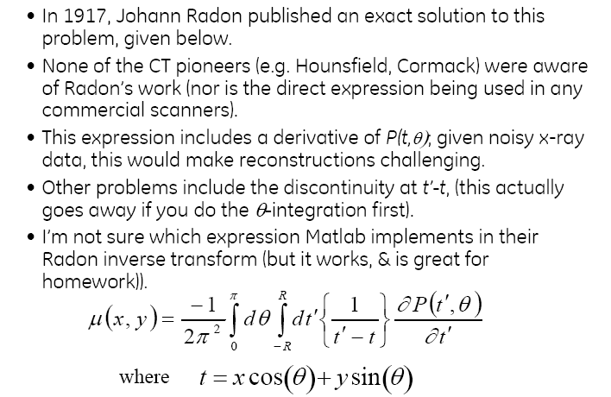
Inverse Radon Transform
Inverse Radon Transform

Slide 30
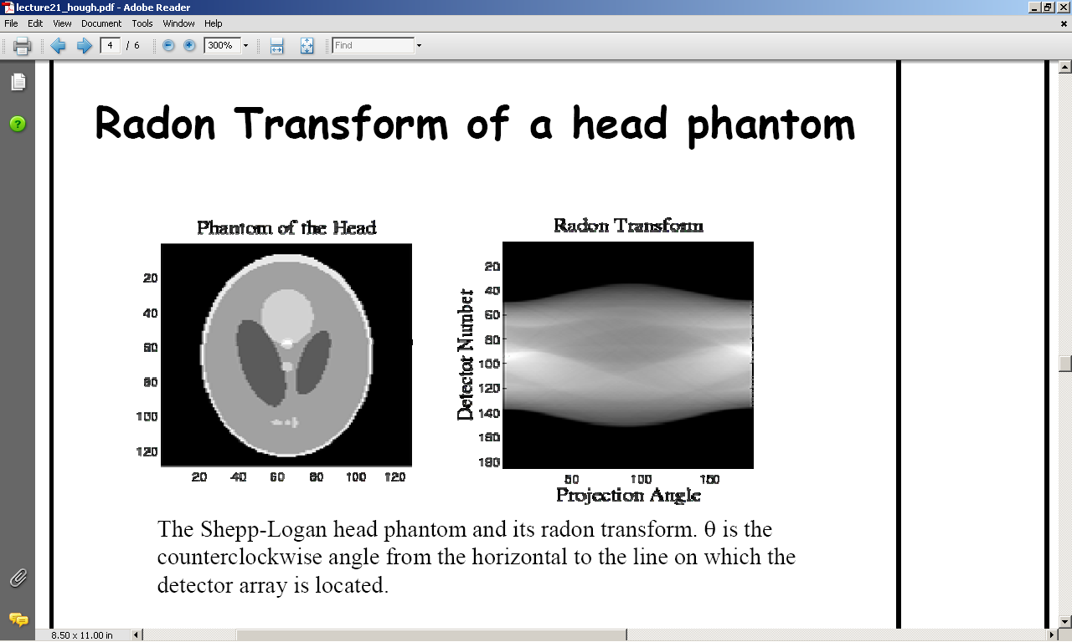
Application of Radon Transform Example

Slide 31
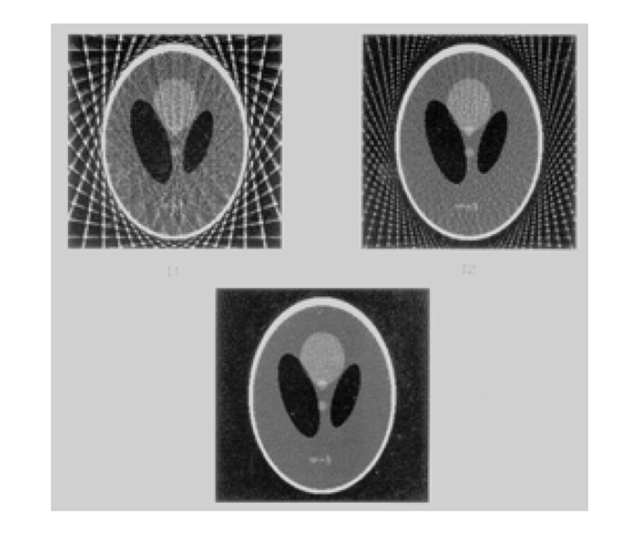
Reconstruction with more Rays

Slide 32
Backpropagation
Principles

Slide 33
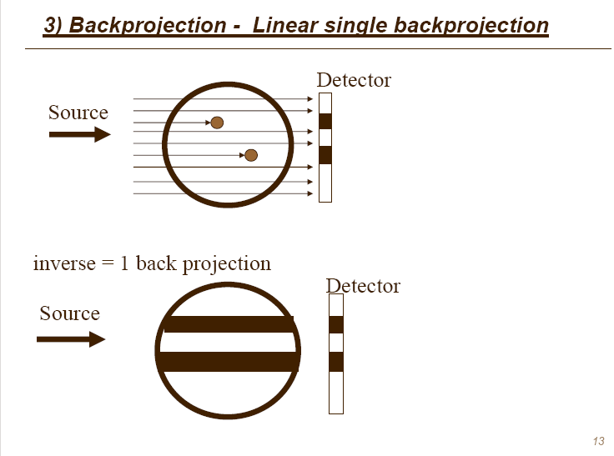
Backpropagation
We know that objects are somewhere here in black stripes, but where?

Slide 34
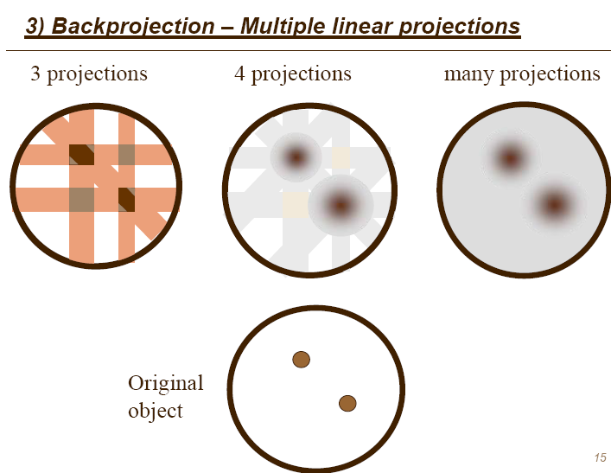

Slide 35
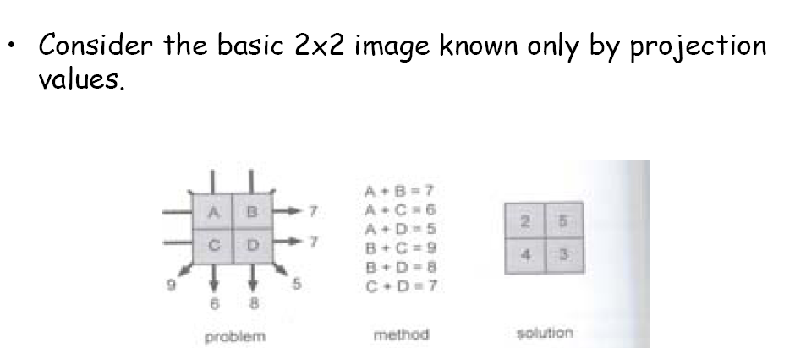
Example of Simple Backprojection Reconstruction
Given are sums, we have to reconstruct values of pixels A, B, C and D

Slide 36
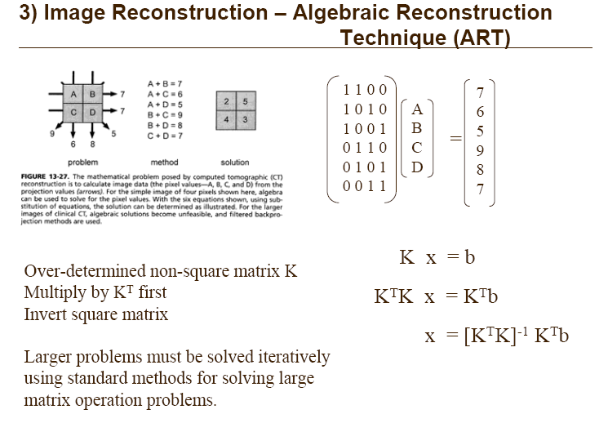
Image Reconstruction: ART or Algebraic Reconstruction Technique
ART

Slide 37
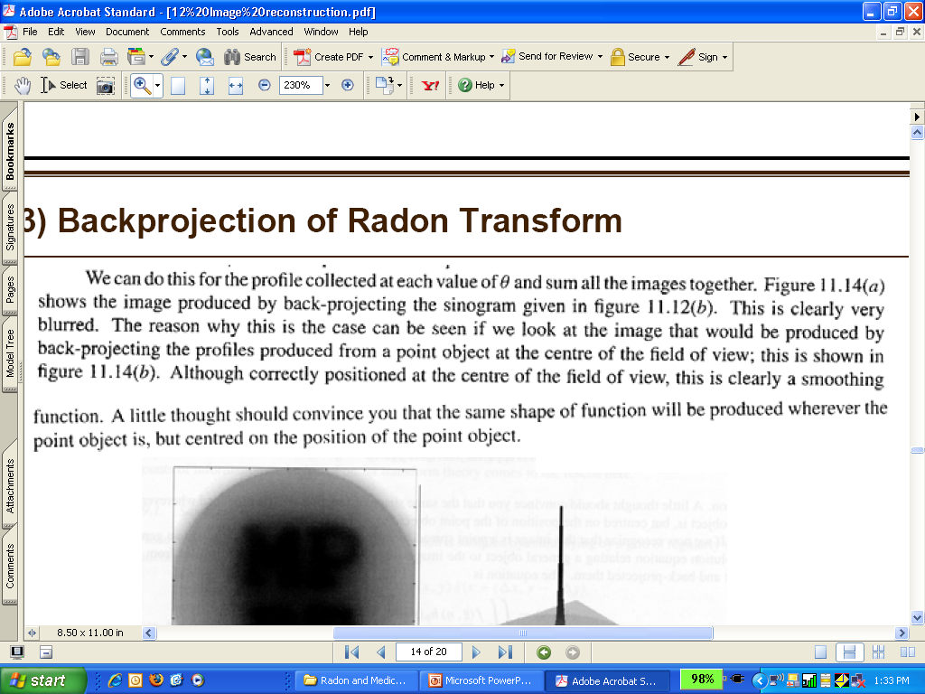
Backprojection of Radon Transform

Slide 38
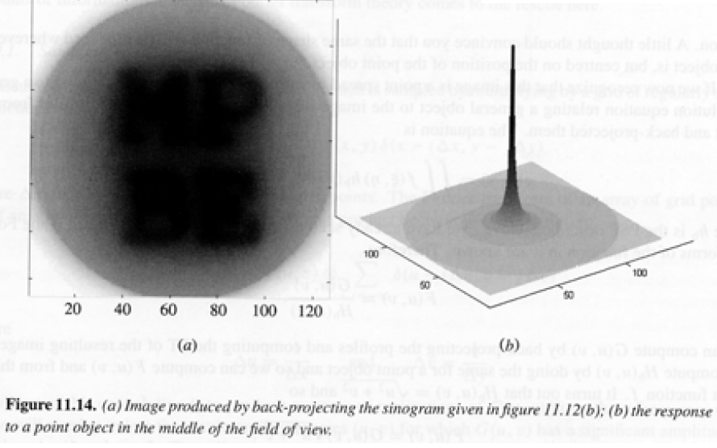

Slide 39
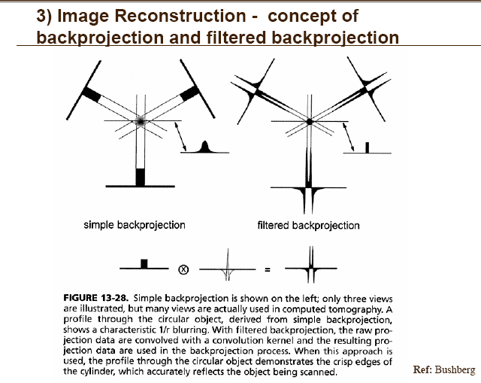
Ideal cylinder
Blurred edges
Crisp edges
Filtered backpropagation creates crisp edges

Slide 40
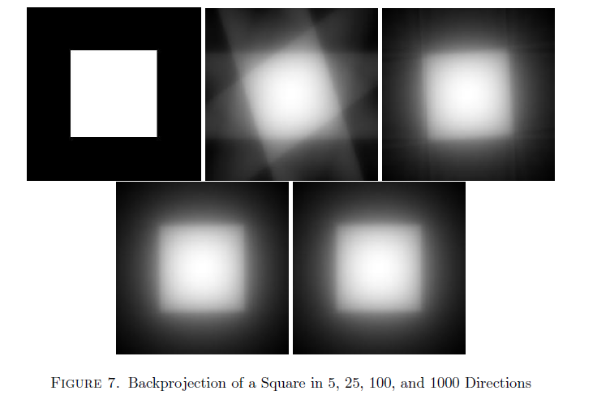
Radon transform back propagation in different directions

Slide 41
Radon Transform - Reconstruction

Slide 42
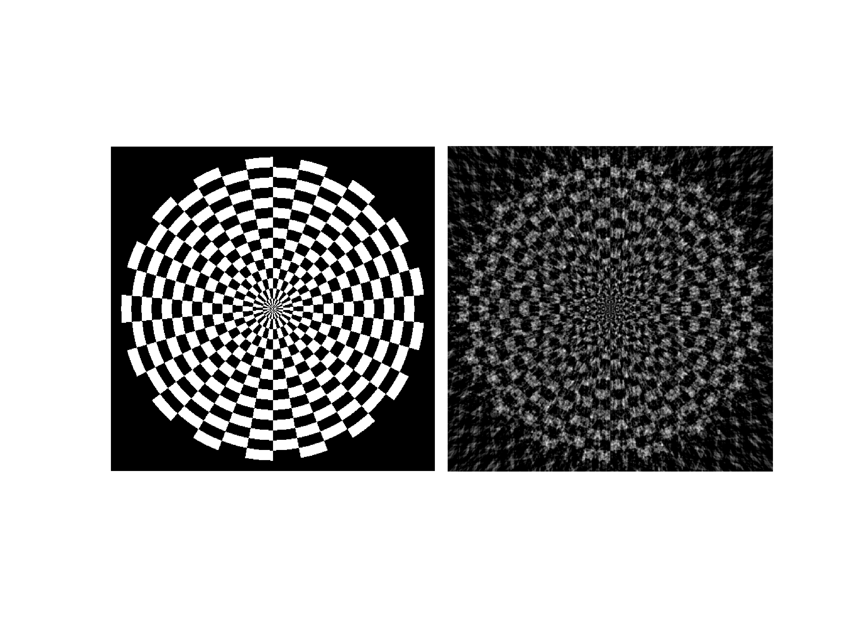
Reconstruction from 32 angles

Slide 43

Reconstruction from 64 angles

Slide 44
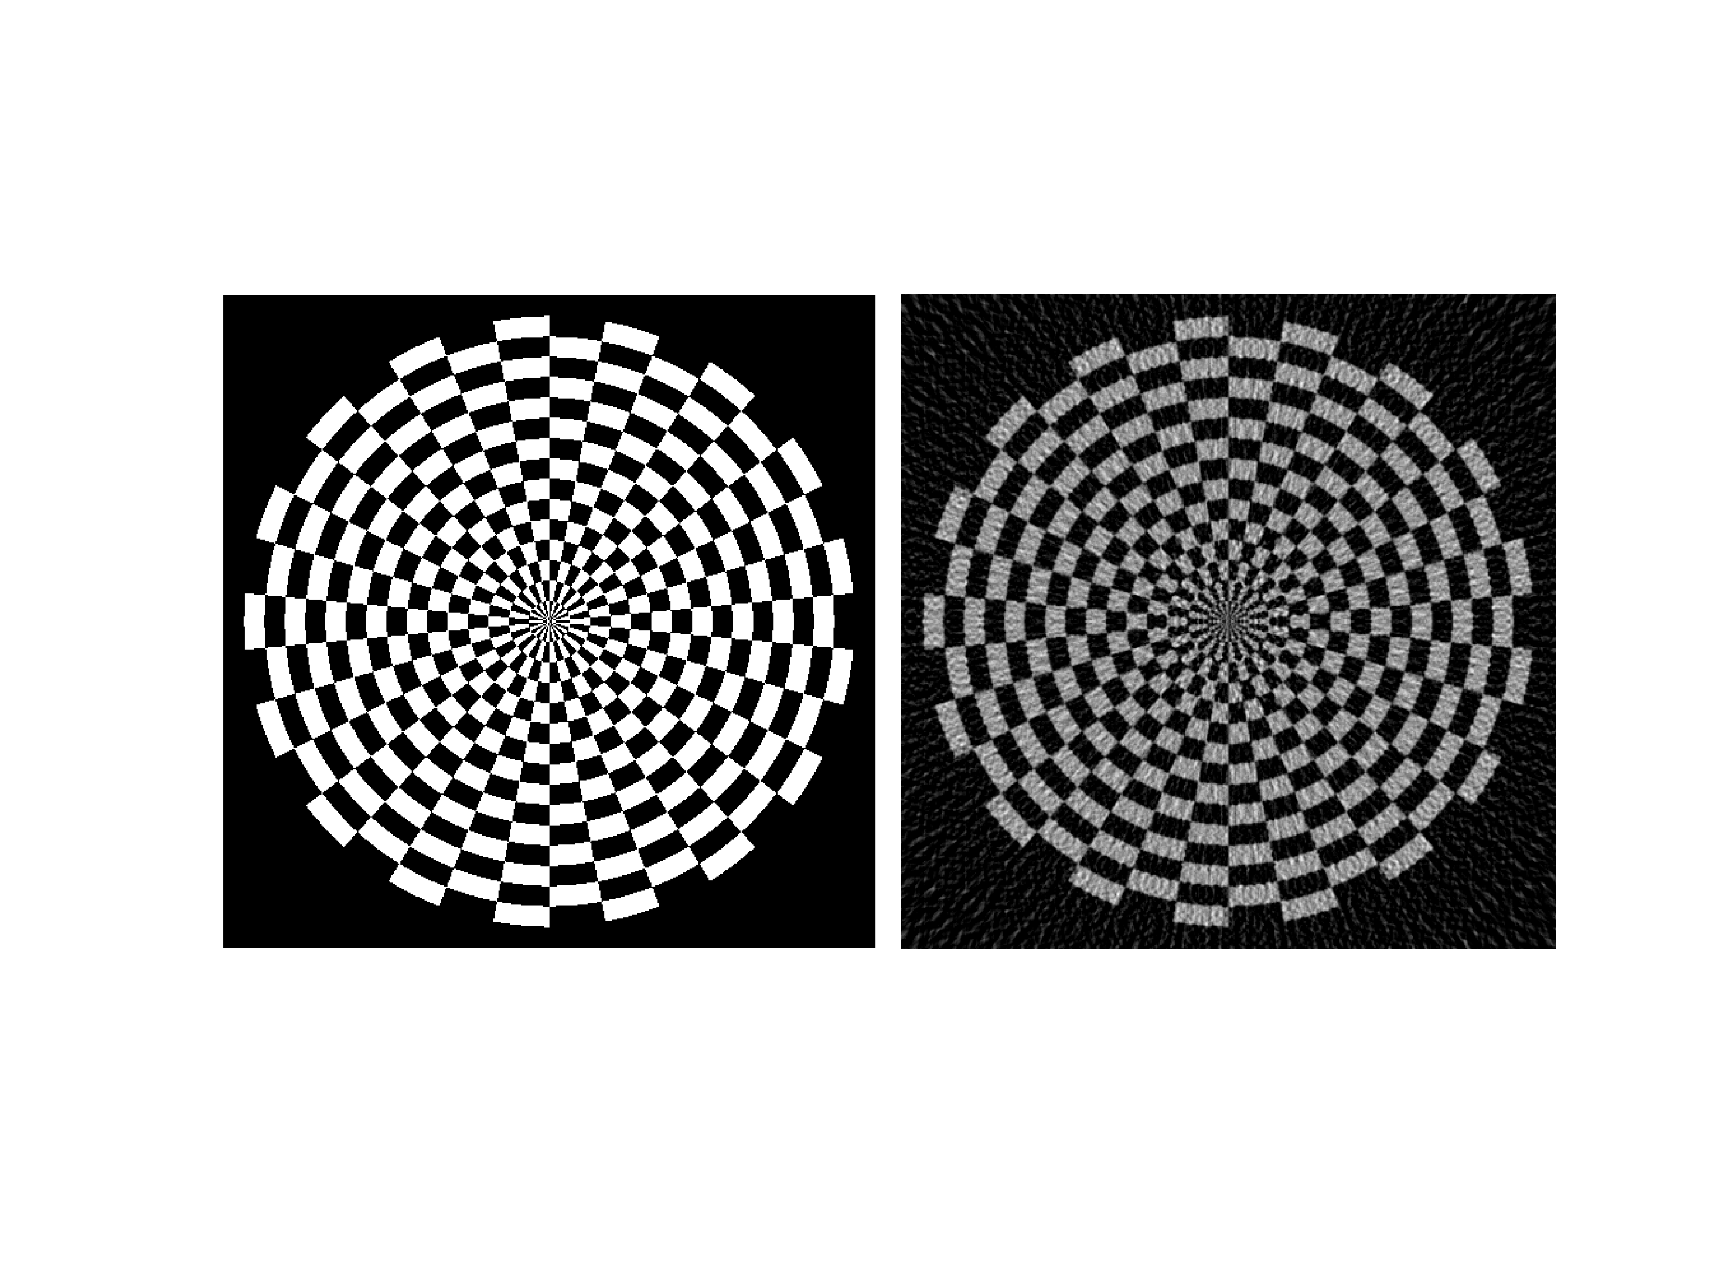
Reconstruction from 96 angles

Slide 45

Reconstruction from 128 angles

Slide 46
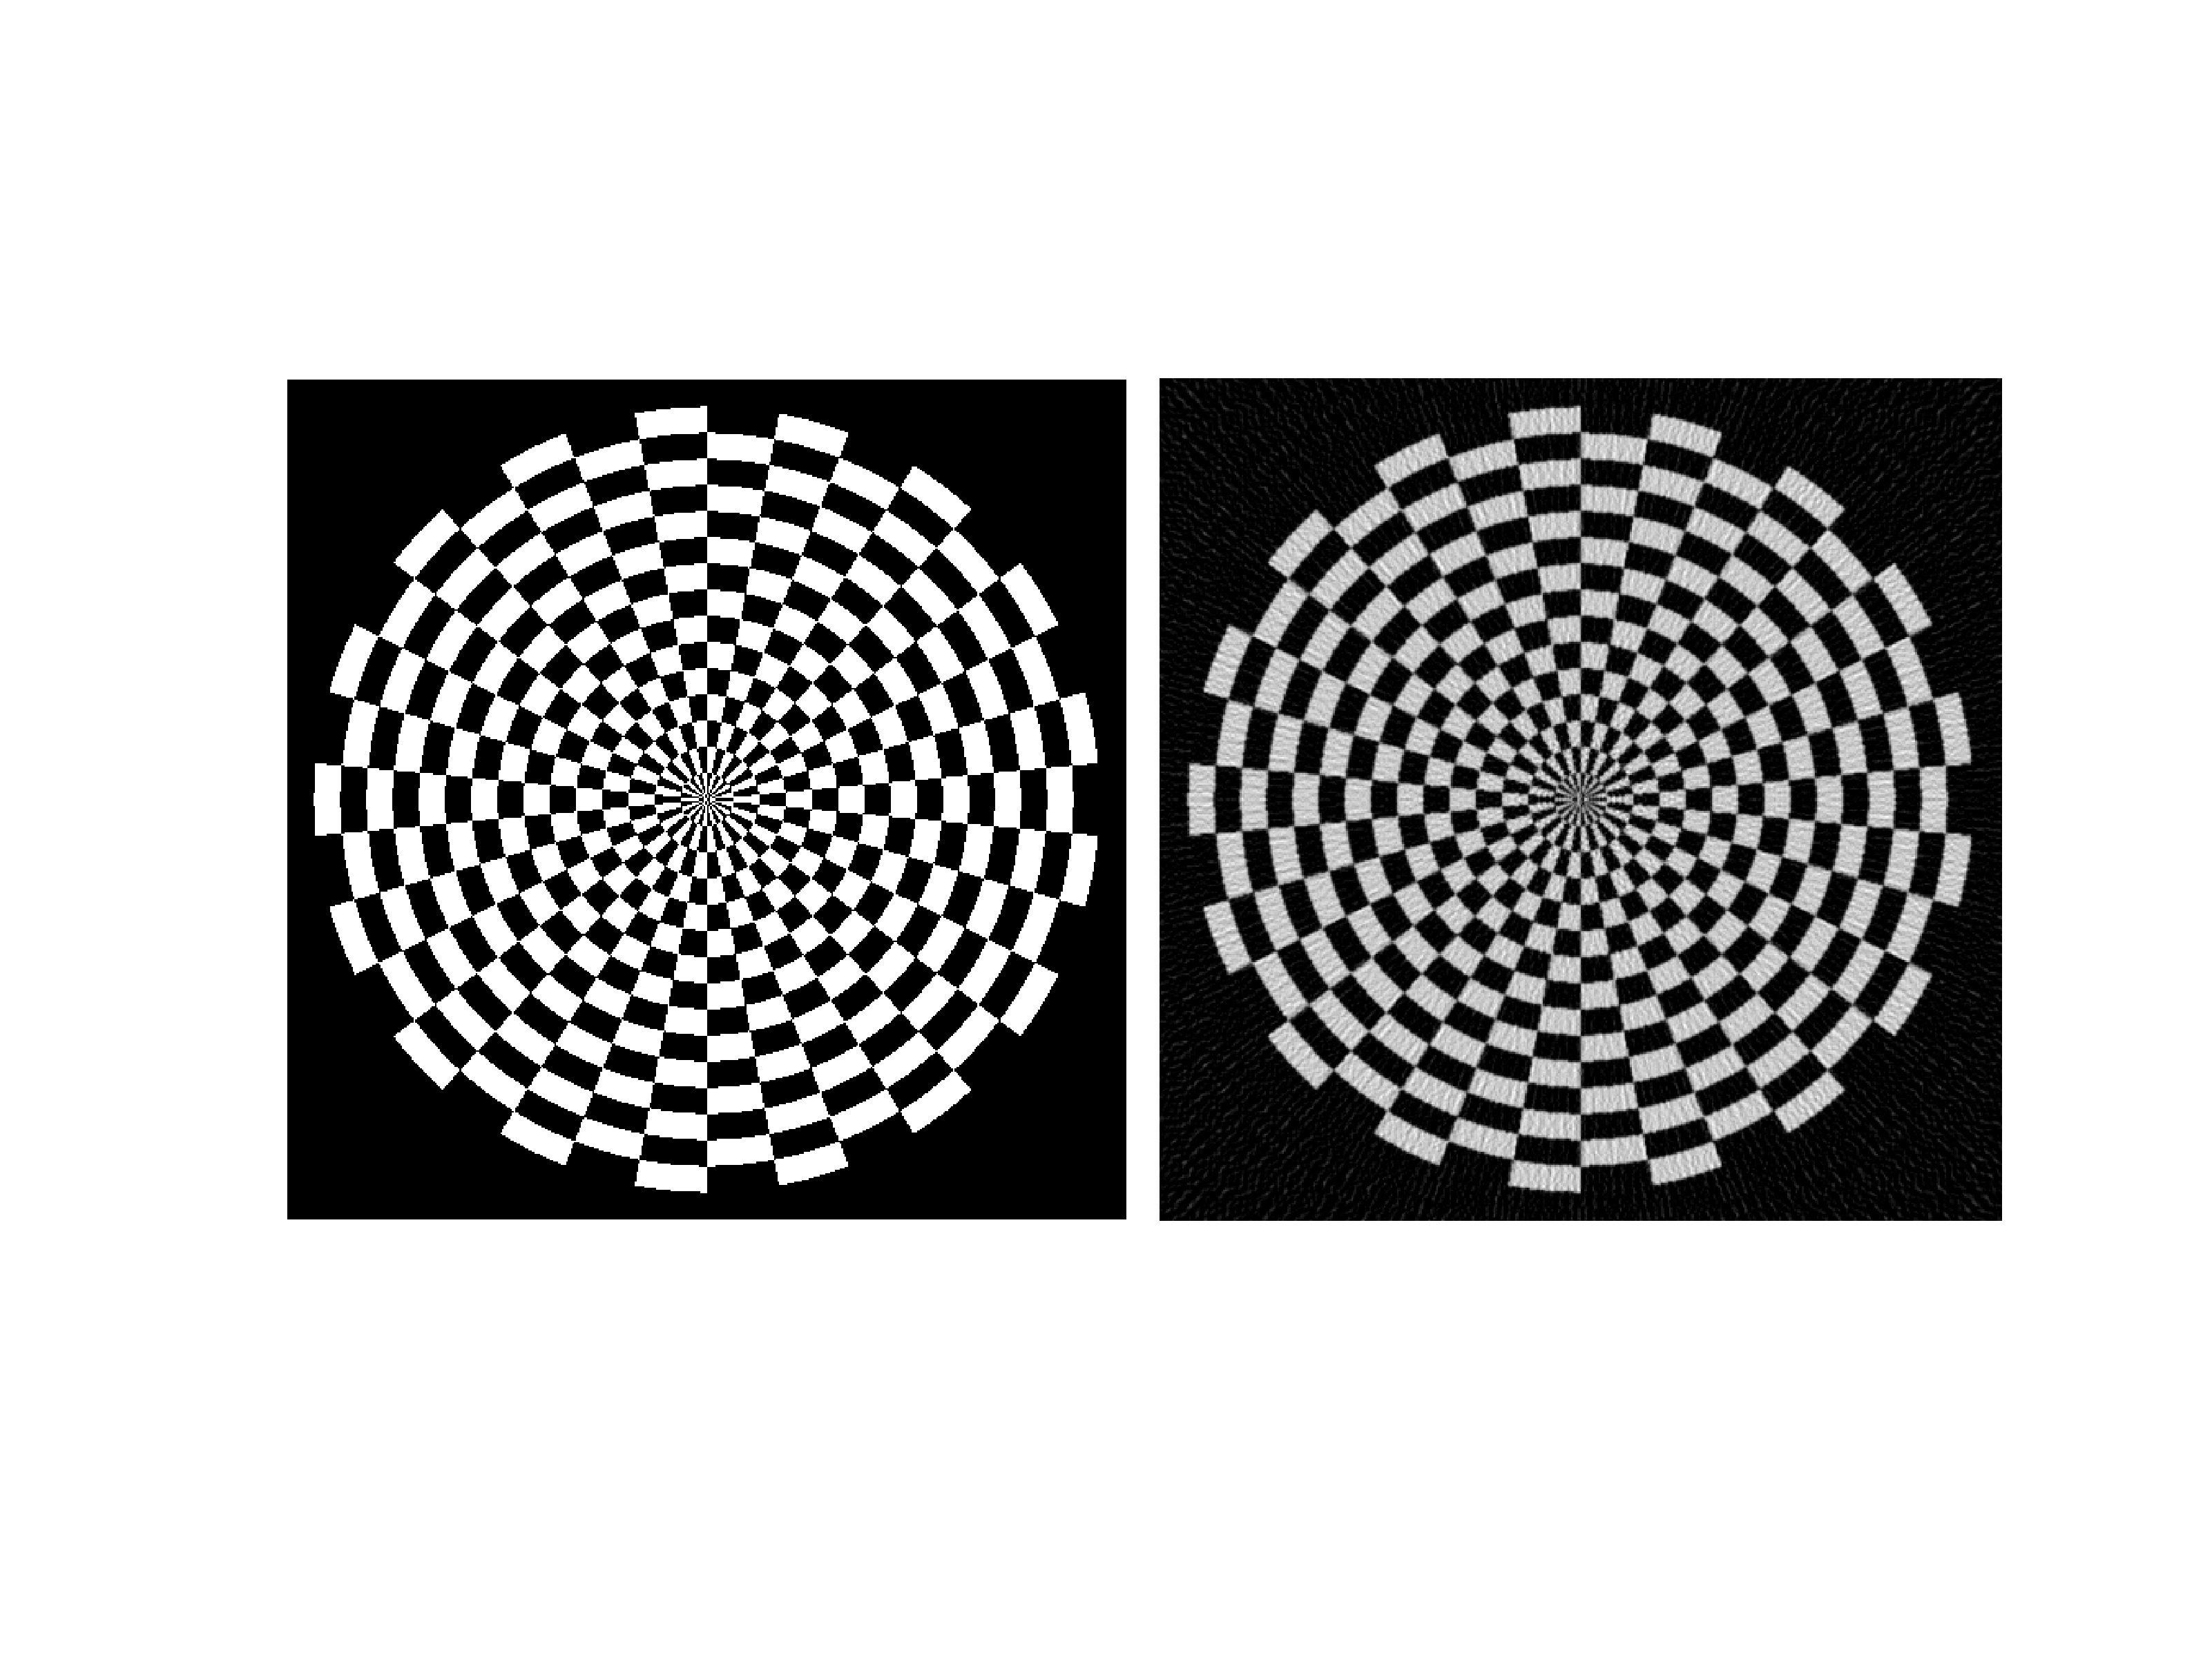
Reconstruction from 180 angles

Slide 47
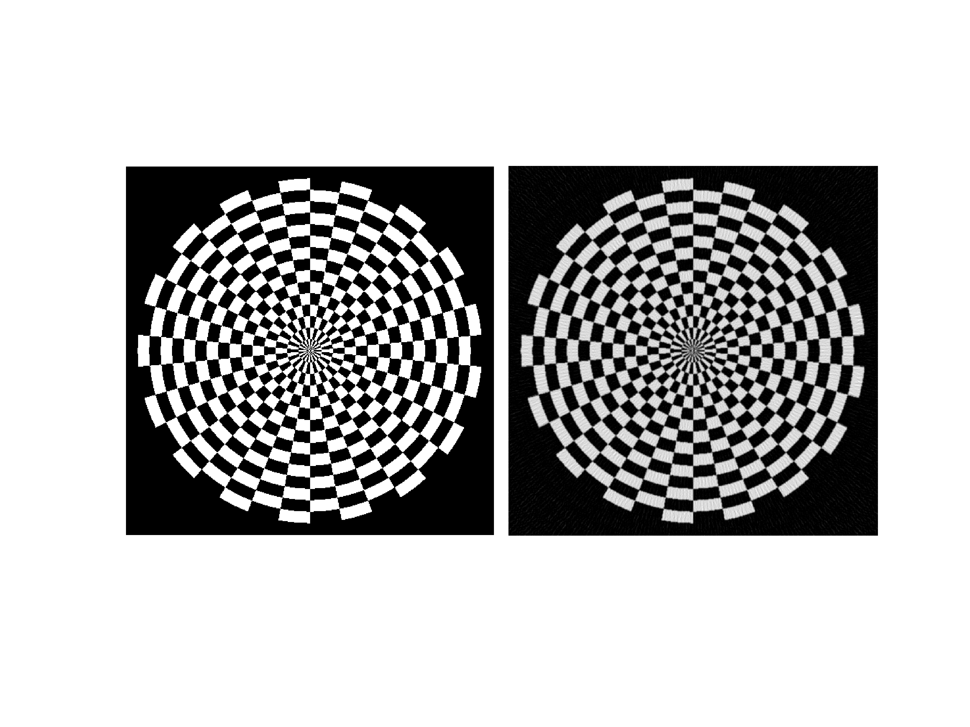
Reconstruction from 256 angles

Slide 48
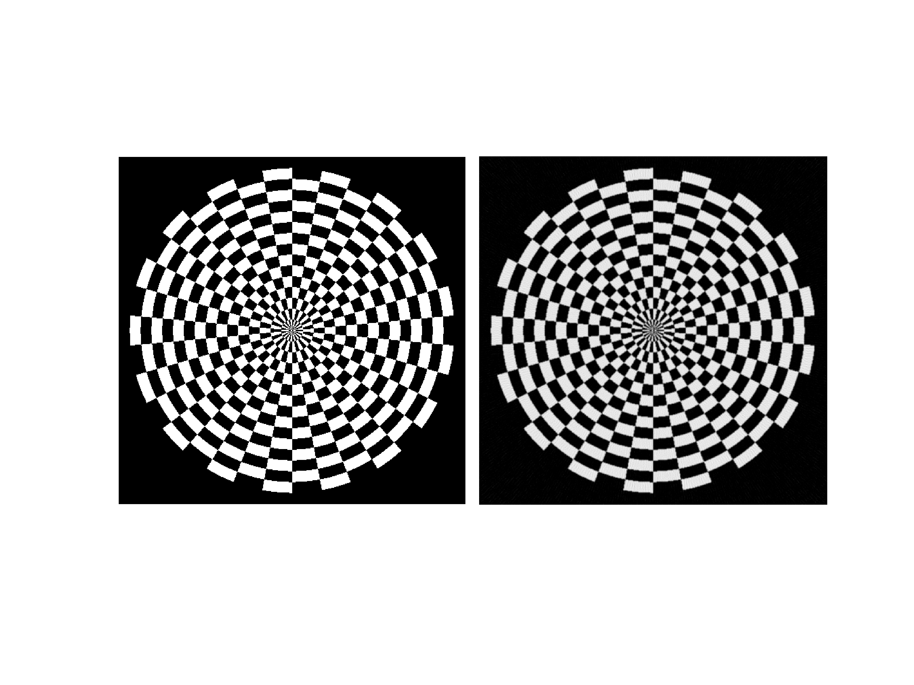
Reconstruction from 360 angles

Slide 49
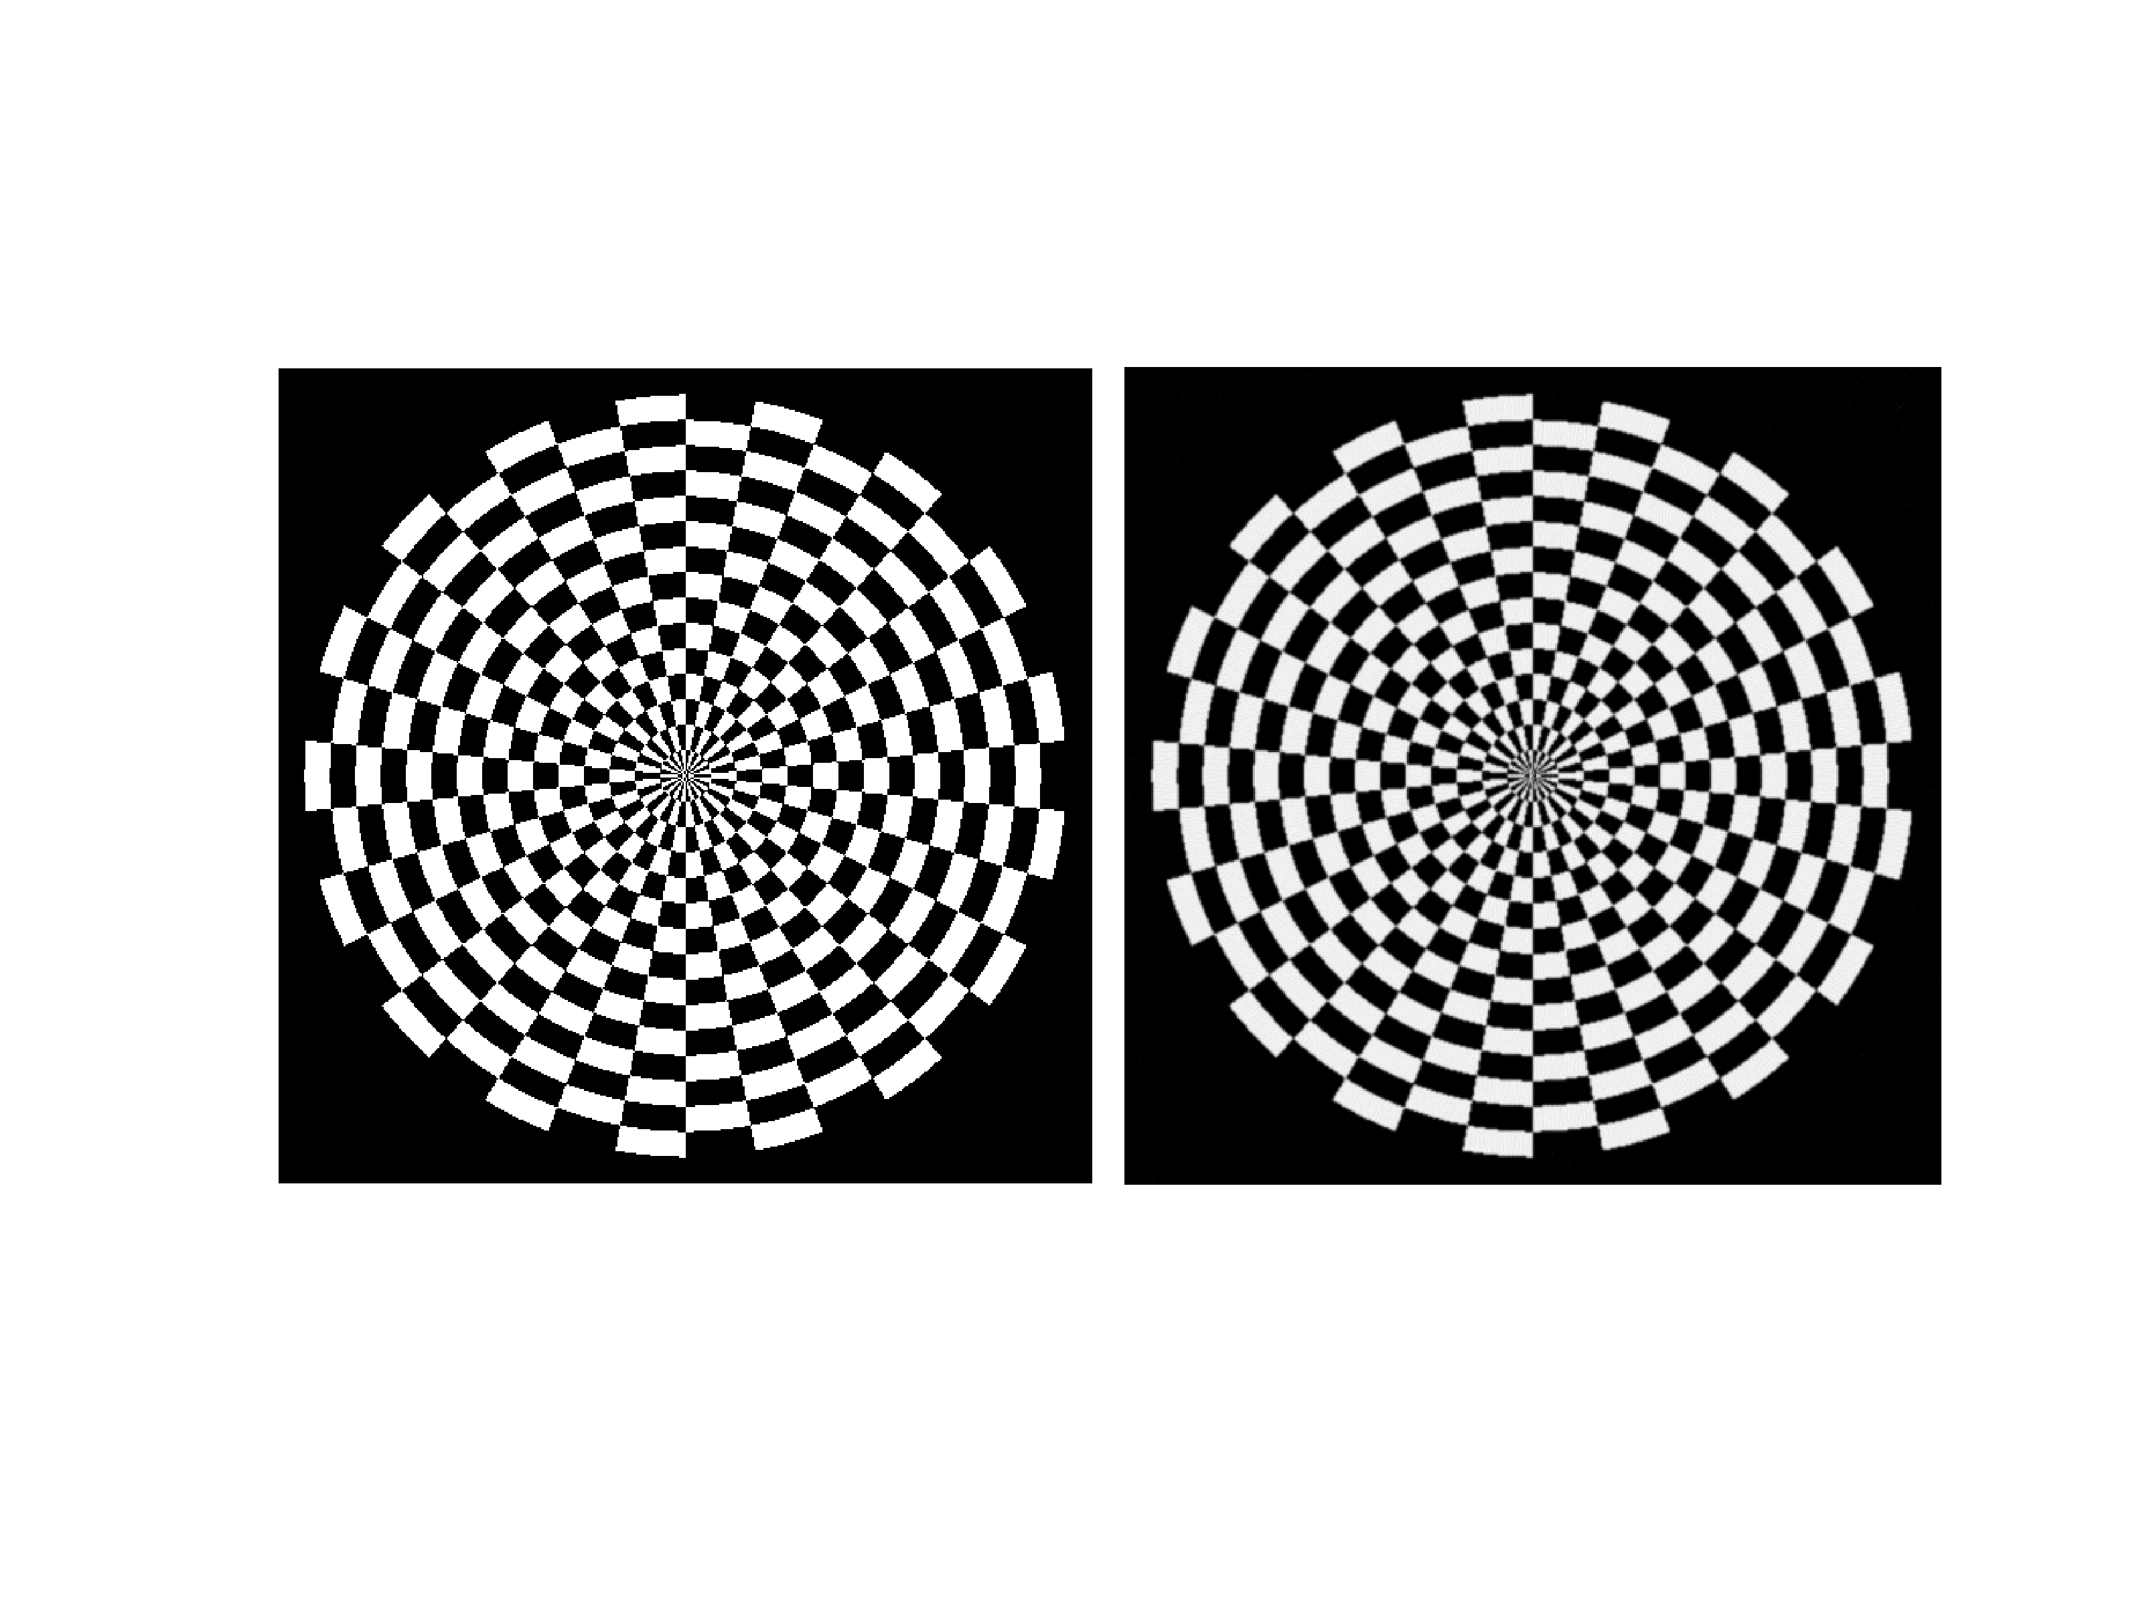
Reconstruction from 512 angles

